Slide 1

Topic: Statistics Investigation EQ: What is the Problem that I need to solve and what mathematics can I use to solve the Problem?
Year 7 Mathematics
Mrs Parlevliet

Slide 2
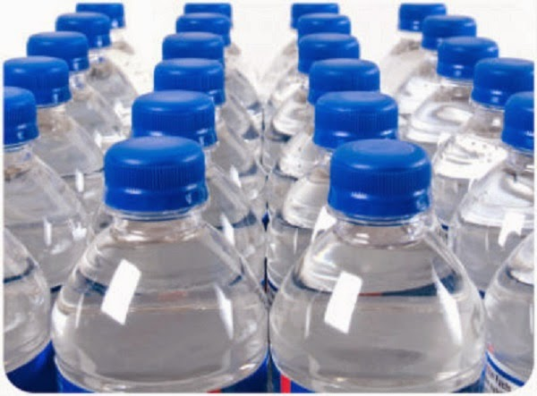
Brainstorm
What happens to used plastic bottles
in Australia?
Notes:
Students need to be sitting in their groups.
Give students 1 minute to work in a group to write down as many possible answers to the question.
Run a whole class discussion to collect responses

Slide 3

Journey of a Plastic Bottle
https://www.youtube.com/watch?v=W41fQOkPJdE
Notes:
Play video.
Compare the information with what was in the video with the answers to the question posed at the beginning of the lesson.

Slide 4
24
7
30
Topic: Statistics
Date: XX/XX/2021
EQ: What is the Problem that I need to solve and what mathematics can I use to solve the Problem?
What part of the Mathematical Thinking Process do I use to solve a problem?
The two steps of the Mathematical Thinking Process that can help me identify the problem to solve and how to solve the problem are:
Analyse information and data from a variety of sources
Primary sources – surveys, personal records
Secondary sources – textbooks, newspapers, tables of data
Apply existing mathematical knowledge and strategies to obtain a solution
Statistical analysis – mean, mode, range
Tables of data
Graphing
Showing working out
Writing your answer in words using your calculated values as evidence to back up your statements.
Notes:
Student Instructions Look at the previous lesson where we covered the Mathematical Thinking Process. What steps can answer our question in the margin? 24/7/30 Skill after writing the notes down. Go back to yesterday’s notes for Steps 3 and 4. What new information have we just learned that we can add to the RHS to better explain Steps 3 and 4? Add that now. Which sources of information are best to use given our short time frame?

Slide 5
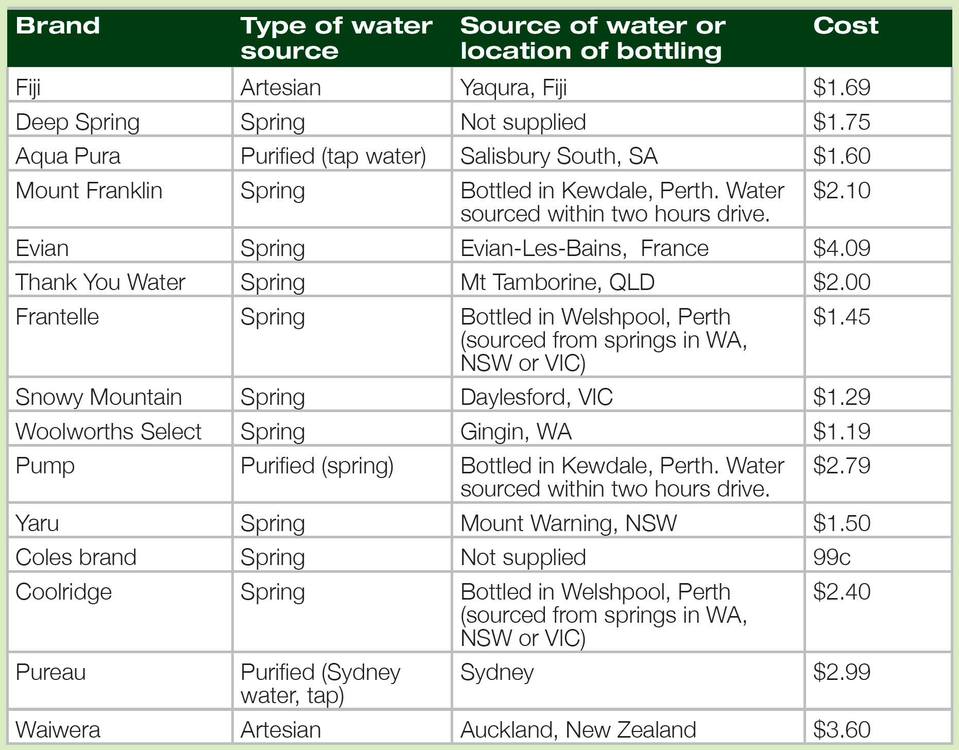
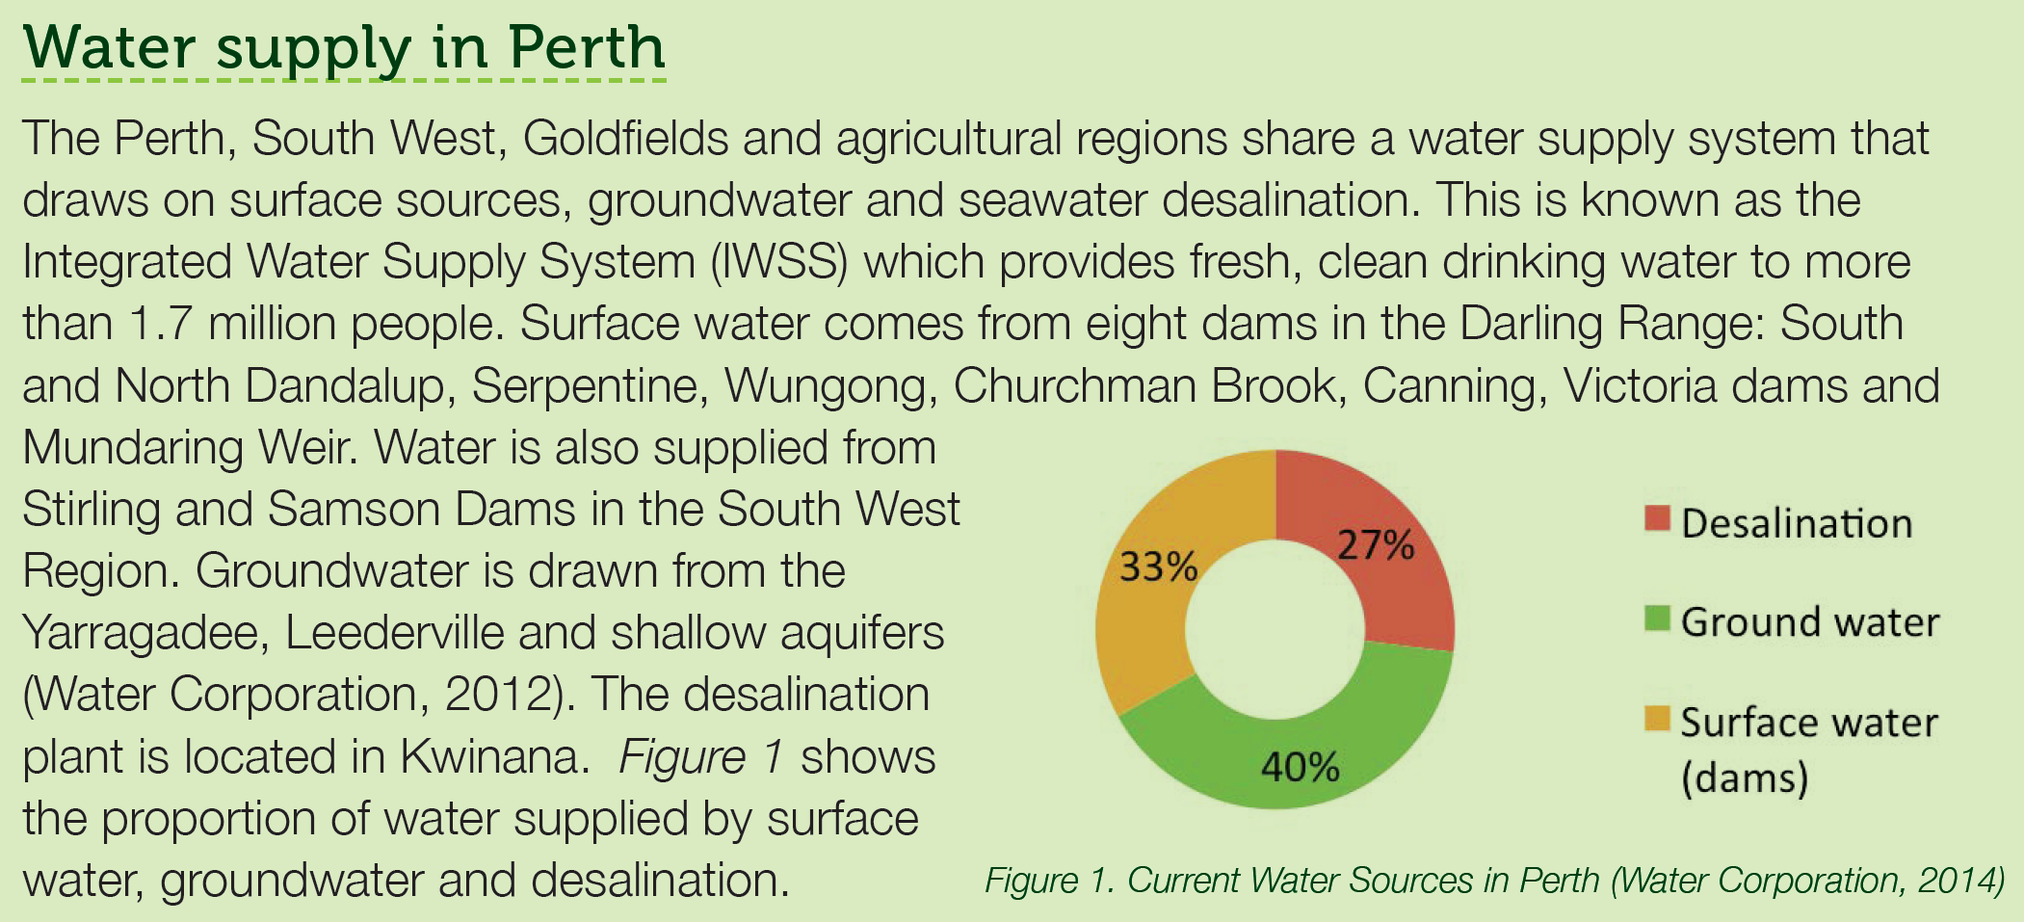
How Far does Water Travel?
Working Collaboratively
Notes:
Can you brainstorm any ideas from the background information and table of values of what type of information you can collect?
How can you collect this information?
When will you collect this information?

Slide 6
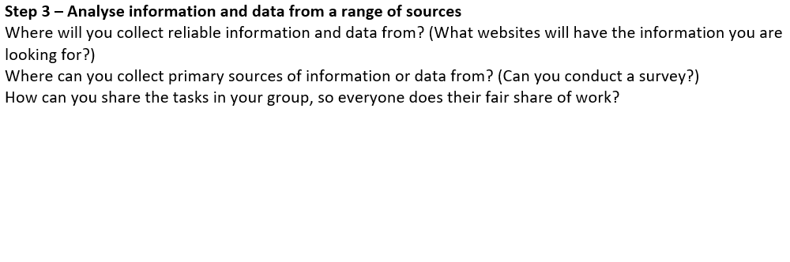
How Far does Water Travel?
Working Collaboratively
Notes:
How will you organise time for researching information from websites?
Can tasks be divided between group members?
What information can you find out when conducting a survey?
Who will you ask?
How many people will you ask?
When will you run this survey?

Slide 7
Distance Travelled by Bottled Water
Bottled Water Brand | Bottling Location | Distance travelled to Perth (km)
Fiji | Yaqura, Fiji | 6385
Aqua Pure | Salisbury, Sa | 2689
Mount Franklin | Kewdale, Perth | 22.2
Evian | Evian-Les-Bains, France | 14239
Thank You Water | Mt Tamborine | 4353
Frantelle | Welshpool, Perth | 24.5
Snowy Mountain | Daylesford, Victoria | 3353
Woolworths Select | Gingin, WA | 76.9
Pump | Kewdale, Perth | 22.2
Yaru | Mount Warning, NSW | 4360
Coolrdige | Welshpool, Perth | 24.5
Pureau | Sydney, NSW | 3948
Waiwera | Auckland, NZ | 5343
Notes:
Provide data to groups for statistical analysis

Slide 8
Distance Travelled by Tap WaTer
Location of Water Source | Distance travelled to Perth Homes (km)
North Dandalup Dam | 99.2
South Dandalup Dam | 112
Serpentine Dam | 88.7
Wungong Dam | 51.5
Churchman Brook Dam | 49.9
Canning Dam | 28.2
Victoria Dam | 28.2
Mundaring Weir | 55
Yarragadee Aquifer | 33.3
Leederville Aquifer | 11.8
Notes:
Provide data to groups for statistical analysis

Slide 9
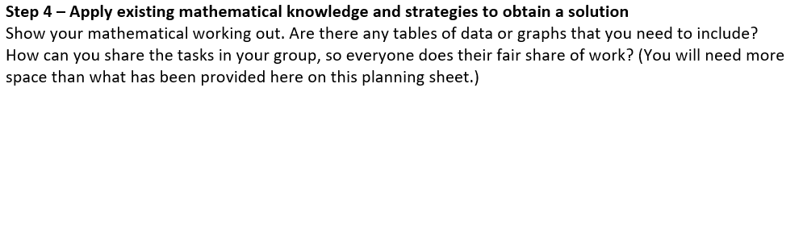
How Far does Water Travel?
Working Collaboratively
Notes:
How will you record the survey results?
How will you display the mathematical information?
Statistical analysis – mean, mode, range
Tables of data
Graphing
Showing working out
Writing your answer in words using your calculated values as evidence to back up your statements.

Slide 10
In Your Groups
Complete Step 3 and Step 4 before the end of the lesson.
Everyone needs to have information written in Step 3 and Step 4.
We are continuing with Step 5 and 6 next lesson.

